Slide 1


An Introduction To
Online Campaigning

Slide 2


Why Campaign Online?
The Nature of UHI
  Over 70 learning centres from Shetland down to Argyll and across from the Hebrides to Perthshire.
  Around 25k students enrolled.
  Students studying online all over the world.
Wider Audience
  Not all students go onto campus but most will likely scroll through TikTok or Instagram.
Creative Options
  Online gives options to be more creative through video content.

Slide 3
What Does Online Campaigning Look Like?
Social Media
  Facebook
  TikTok
  Instagram
  LinkedIn
Online Forums
  Reddit
Streaming
  YouTube

Slide 4
Get the Messaging Right
Why should students vote for you?
Why you are running
  What makes you a good candidate
  A bit about you: What you study, your hobbies, your interests
What role are you running for
  Make sure the students you want to represent know they can vote for you
Explain your manifesto
  Get across the key points of what you want to change if elected.

Slide 5
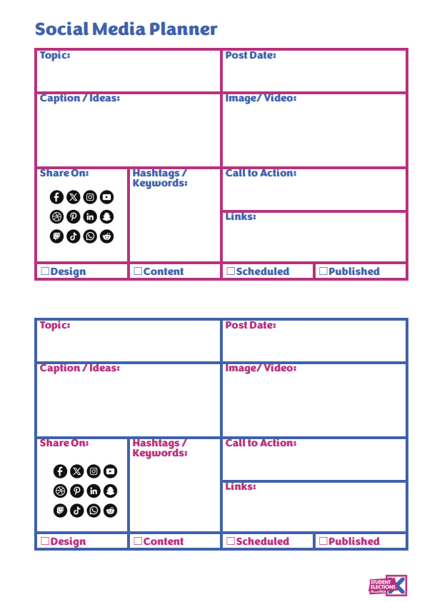
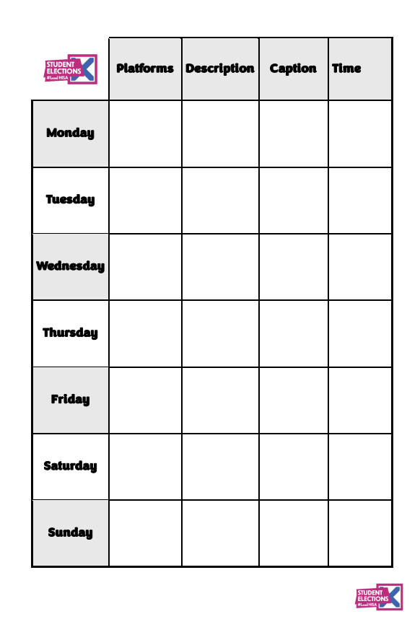
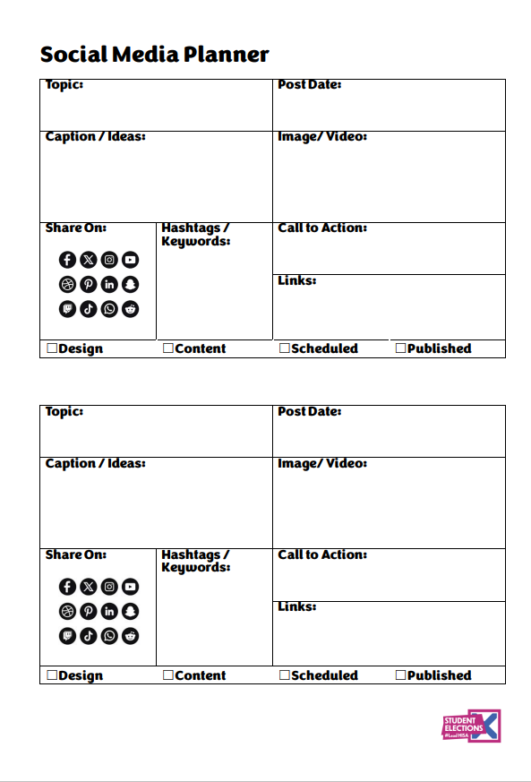
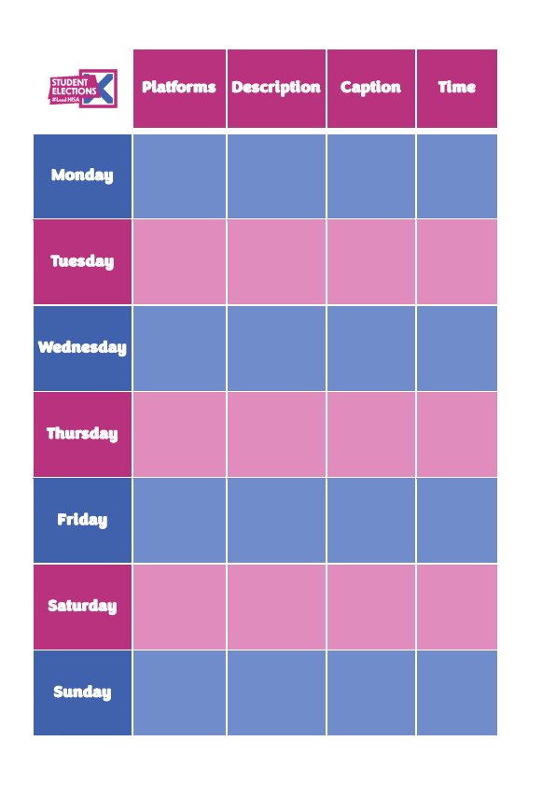
Tips and Tricks!
Facebook Page specific for your campaign
Use the appropriate hashtags #LeadHISA #ThinkUHI
Create a brand across platforms; keeping messaging, visuals and tone consistent
Plan your posts ahead for the duration of the campaign period with content summary, platforms, days, times etc.
Utilise your friends and families to like and share your content.
Be accessible where possible i.e alt-text on images posted.
Avoid language that could be offensive or derogatory.
Find non-copyrighted images and graphics for your content

Slide 6
Maximise Engagement
Useful Resources
What to Post
  Create engaging and effective social media content – Hootsuite Help Center
Sourcing Images, Graphics and designs
  500+ Non Copyrighted Pictures [HD] | Download Free Images on Unsplash
  5.3 million+ Stunning Free Images to Use Anywhere – Pixabay
  www.canva.com
When to Post
  Best Times to Post on Social Media in 2025 [For Every Platform] | WordStream
Find Inspiration!
  Search www.youtube.com for “student union election campaign videos”

Slide 7
Know the Rules
YOU MUST NOT breach copyright or creative commons
  Using images, music or written content without permission is not permitted. A lot of images found on Google Image search are usually copyright protected.
  Failing to reference content source/creator when permission has been given to use the content, can be considered a copyright or creative commons breach.
YOU MUST NOT post content considered to be discriminatory, bullying, or harassment
  Do Not make offensive or derogatory comments relating to sex, gender reassignment, race (including nationality), disability, sexual orientation, religion or belief, or age.
  Do Not make negative comments relating to any individual or towards the other candidates.
  Do Not Post images or links to content that are discriminatory or offensive.

Slide 8
Follow the Rules
Online Campaigning Rules
No online campaigning must take place before the date and time outlined in the relevant Candidates Nomination Pack.
Candidates may use and/or create their own website and social networking page to promote their campaign. Any costs incurred for this must come out of your campaign budget.
Candidates can set up a social media group and/ or page to outline the fact they are running in the election before online campaigning commences, however, must only state that you are running and cannot outline your manifesto points or ask for their vote. You cannot publish your manifesto online or launch a specific campaign website (e.g. www.voteforjoe.com) before the online campaign period.
Candidates and their campaign teams may not use Brightspace, the university's Virtual Learning Environment (VLE), to promote themselves or their campaign.
Candidates may not use any UHI or HISA contact or mailing lists to promote themselves or the campaigns. Candidates may create their own contact/ mailing list for the purposes of campaigning; third-party any such lists must not contain or use any information collected from any third-party source (i.e. contact lists, email lists, social media groups, etc…) and must be General Data Protection Regulation (GPDR) compliant.
Candidates and their campaign teams may not use Bluetooth or Push Messaging to promote themselves or their campaign.
View all Rules here:
HISA Election Rules

